Slide 1


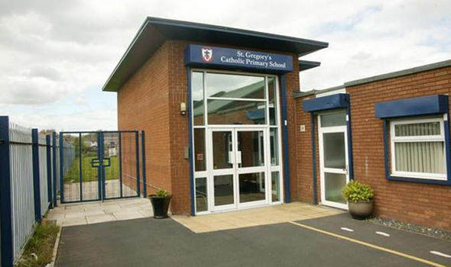
St Gregory’s Catholic Primary School Curriculum Handbook
We Will Live, Love and Learn with Jesus

Slide 2

Curriculum Content
The National Curriculum is not the whole curriculum
The National Curriculum sets out the subject requirements that maintained schools are required to follow
It is useful to think of the National Curriculum as a baseline that can be included in a school curriculum
A school should decide how the curriculum can be put together in the most exciting and effective way
A school should also consider what else is required to make a really outstanding curriculum that will inspire and challenge all children and prepare them for the future
At St Gregory’s we teach all of our subjects as stand alone lessons, through different topics. However, we do make cross-curricular links where possible. For example, if the History topic is ‘The Romans’ the children may write a story set in that era (English) or locate the Roman Empire on different maps (Geography).
We believe as a result of the curriculum being delivered this way, children can learn the keys skills for each subject but also apply these skills across the curriculum.

Slide 3
Values taught through our curriculum
When you come into our school, we help you to learn and grow through:
The British Values you learn The Gospel Values you live
The Religious education you are taught
The relationships you experience
The Physical Education curriculum Assemblies
Collective Worship
Masses Sacramental Preparation
Social, Moral, Spiritual and Cultural Education

Slide 4
British Values taught
Respect
Rule of law
The Gospel values permeate all that we do and inform the life we seek to live and foster as British citizens.
Where all children and adults respect and obey the law, feel they make a contribution and are valued as individuals.
Where the integrity, dignity and opinions of each individual is acknowledged and respected.
Where respect and tolerance of different ways of life are nurtured, established and practiced.
Where the whole school community are enabled to achieve their full potential.
Where strong partnerships exist between children, parents, staff, governors and the community as a whole.
Where the school community have genuine respect and pride in themselves and the communities and environment in which they live.
We place a great emphasis on putting our values into action and our children are supported to understand that their actions reflect their values. We believe in our children and expect them to:
Aspire to positions of responsibility such as Play Leader, School Councillor, Subject Ambassador etc
To be able to be trusted to do important jobs around our school
To receive School Awards
To organise Charity Events
To take part in an event which serves the local community
To look after younger children
To help with chores at home every week
To complete homework to a high standard every week
To be told by their teacher that their work is presented well all of the time
To wear full uniform every day. Uniform in our school reminds us that we are a team working together and helping each other. It reminds us that, even though we are very different as individuals, we have a lot in common.
Plus lots more!
Democracy
Individual Liberty
Mutual Respect

Slide 5


Attendance
We can’t teach an empty chair!
At St Gregory’s, we believe that attending school regularly is important to ensure the best possible learning outcomes for all of our children. Everyone in our whole school community takes responsibility for attendance.
Attending school regularly means:
Children can make the most of their education, improving their chances in adult life.
Children will develop their social skills, such as making and keeping friendships.
A regular and punctual attendance pattern will help children when they progress to high school and eventually enter the world of work.
Our school moto for attendance is:
“We can’t teach an empty chair!”
We encourage and motivate children to become attendance heroes –
H here
E everyday
R ready
O on time

Slide 6


Dojo Points
ClassDojo is a behaviour management tool for the classroom. Each child has a profile – complete with their own dojo emoji – to which teachers can assign positive and negative points (or 'dojos') throughout the lesson.
The programme will be operated by a teacher or teaching assistant from their computer or Ipad. This information is then recorded on each child’s profile so that it can be reviewed throughout the year.
Parents also have logins so that they can view their child's achievements from home. Any child who has shown good behaviour; for caring for each other; politeness, respectfulness etc. during the week is awarded a dojo point by any member of staff. Lunchtime supervisors will also give out dojo points. They will choose three children each lunch time that they feel deserve to be awarded a dojo point for any of the above behaviours.
When a child receives 100 Dojo’s they will receive a Bronze Certificate.
When a child receives 200 Dojo’s they will receive a Silver Certificate.
When a child receives 350 Dojo’s they will receive a Gold Certificate.

Slide 7
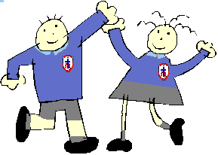
Responsibilities of Subject Ambassadors
Children in Y2-Y6- Chosen by teachers.
Role & responsibilities:
To share a love of their subject with their class and around school
To celebrate subject achievements
To introduce competitions and new ideas
To raise the profile of their subject in school
To lead activities relating to their subject
To give the pupils in their class and in school a voice and help them to share their ideas
Subject ambassadors should support their Subject Champion to develop a ‘Curriculum for Life’ ethos around St Gregory’s
Qualities/Skills required:
To be a good team member
To be able to develop good relationships with pupils of all ages and be able to encourage them
Be a positive role model and have a good attitude towards learning and maths
Be able to recognise other pupils’ achievements
To have clear and open communication with staff at St. Gregory’s
Commitment:
On-going commitment to be a good role-model
Use of playtimes/lunchtimes to arrange events when required.

Slide 8
Responsibilities of School Council
Boy and Girl from each class- Voted for by peers.
A school council represents the views of all pupils. It gives children the opportunity to make their voices heard and feel part of the whole school community.
A school council helps to make changes and improvements, and tries to make the school a nicer place for everyone.
Election Process
At St Gregory’s, every class in Key Stage 2 chooses two representatives to be members of the school council.
Voting for council members takes place at the beginning of the school year.
Before they are voted for, nominees have to give a speech to their class explaining why they want to be on the council.
What makes a good school councillor?
A School Councillor needs to be able to:
speak out
take their role seriously
put across good ideas
care for others
be a good role model who can be trusted
be reliable
keep to the subject
show enthusiasm
What could they change?
There are many projects and aspects of school life that the
School Council could get involved with. Here are some examples:
Lunchtimes/Playtimes
Areas around school e.g. cloakrooms, toilets
Equipment for our playground
ICT equipment/suggest apps for iPads
School environment – Litter – Recycling
Raise money for charity
Improve our classrooms
Help to organise special events/competitions
Help shape our curriculum
What will our school council do?
We will hold regular meetings to discuss ways in which we can improve our school. The Councillors will present the views of their classmates. They will provide feedback in a number of ways:
through the school website
in class discussions and assemblies
using the School Council noticeboard.
The school council also meet with the school governors to discuss their plans for the year ahead.
How do pupils contribute their ideas?
Children can put their ideas forward to the school council by speaking to a school council representative.
Posting ideas in the suggestion box writing suggestions and handing them to councillors

Slide 9
Responsibilities of Playtime Buddies
Y5 children- Chosen by teachers
Peer Advocacy is when a pupil speaks up for another pupils who is too shy, worried or frightened to say how they feel.
The role of the peer advocate/buddy is to listen to other pupils in school and on the yard and help them to make their views known.
Children are trained in school to develop listening and communication skills so that they can support other pupils. They will also learn when to get help from an adult if they need it. Buddies will be trained and supported by Mrs Green and Miss Blanchard.
The benefits of Buddies in school include;
Reducing incidents on the playground
Creating an environment in which pupils feel able to talk about their worries and are more confident that they will be supported
More arguments are solved quicker so don’t carry on in class
They help to make the playground safer as they are trained in when to get help from a member of staff
They can support new pupils or pupils moving between key stages.
The position of buddy is very highly regarded within the school community. Buddies will be responsible for helping staff ensure the smooth running of playtimes and lunchtimes by supporting children on the playground.
Key responsibilities
Supporting younger children in the dinner hall with routines and processes around hot meals and packed lunches
Spending time on both KS1 and KS2 playgrounds supporting children in their play and introducing new games
Working with children to help them settle friendship problems in a fair way
Ensuring all children are happy and included in play

Slide 10
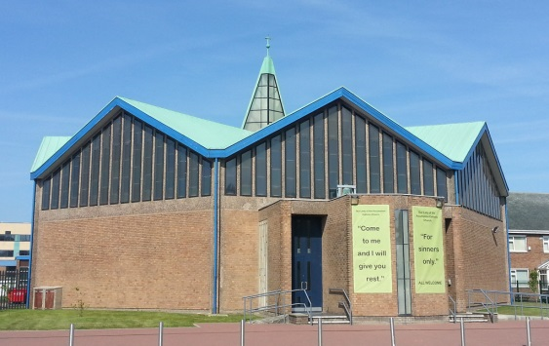
Our Prayer Life
St Gregory’s belong to the Parish of Our Lady of the Assumption. Year 4 children prepare and receive the Sacrament of Reconciliation and Holy Communion with the support of the parish and families.
Our Assemblies
Each of our Star of the Week Assembly is linked to our Values. The Gospel of Jesus Christ, as expressed in scripture and Church tradition, is at the centre providing direction, motivation and spiritual depth to each of these values.
Collective Worship
Collective Worship happens daily in each class. This is a time for children to gather together, listen to scripture, respond to each other and go forth, living out the messages from each celebration. Children are involved in planning and delivering different celebrations.
School Masses
KS2 classes take an active part in the celebration of Mass once a term. Families and Parishioners are invited to join.
All children and staff participate in all special celebration Masses, following the Liturgical calendar.

Slide 11
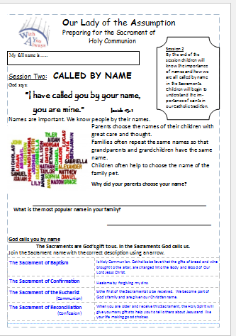
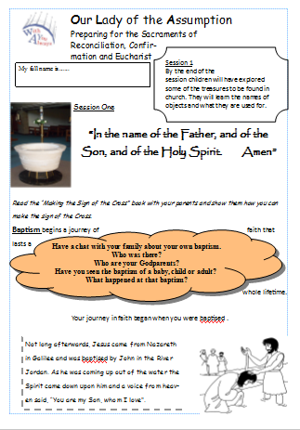
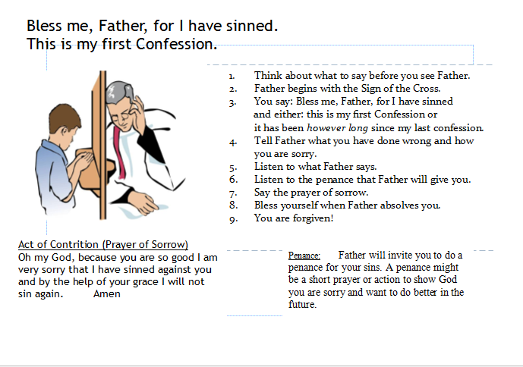
Sacramental Preparation Sessions
At the end of Year 3 (June) children and parents will be invited to apply for the preparation course that begins in the September of Year 4. Children from Catholic schools and non-Catholics schools who have been baptised are welcome to take part. The process of preparation is called, ‘Family Catechesis’ and builds on the parents being the ‘first and best teachers of their children in the ways of faith.’ Preparation takes place each week at mass and there are monthly sessions either at 2pm or 6pm whichever is more suitable for the family situation.

Slide 12



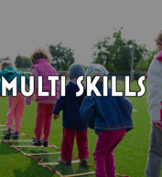








Extra Curricular Clubs
Family Fitness
Booster
Clubs

Slide 13




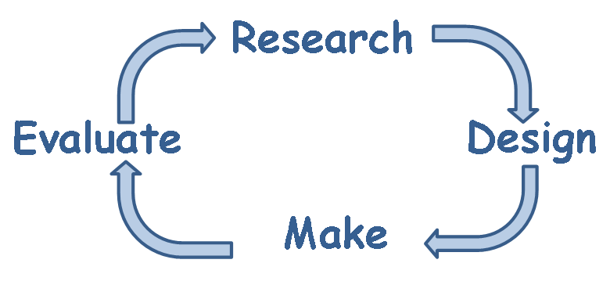

Themed Weeks
Subject | Date
RE- Faith Week | 9th October-13th October
Science Week | 16th October-20th October
Anti-Bullying Week | 13th Novermber-17th November
DT/Enterprise Week | 20th November- 24th November
RE-Faith Week | 15th January-19th January
Spanish Days | 24th/25th January
Online Safety Day | 6th February
DT Week | 21st May-25th May
Health & Fitness Week | 18th June-22nd June
Perfect Maths Day | 28th June

Slide 14

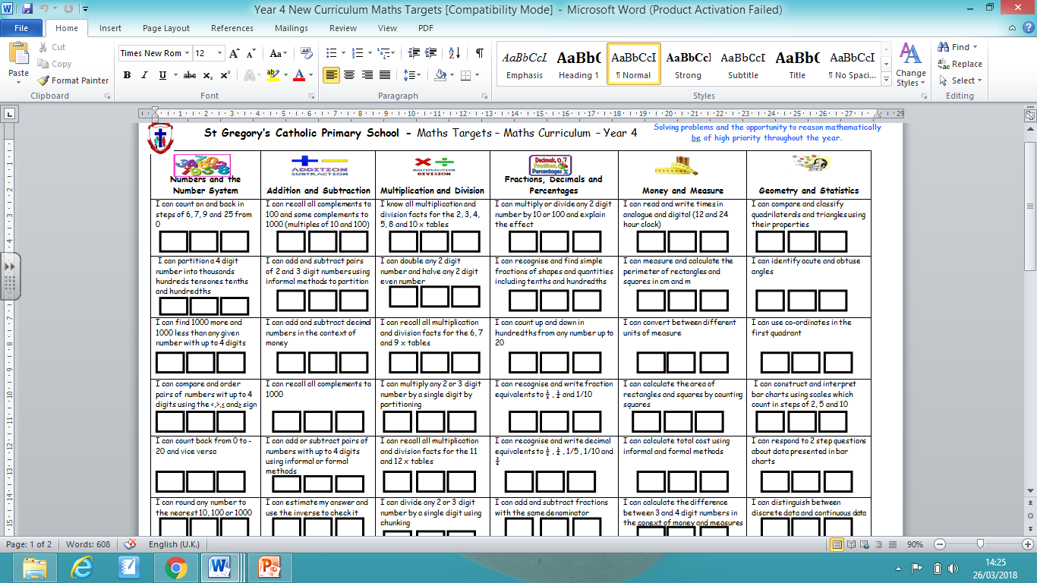
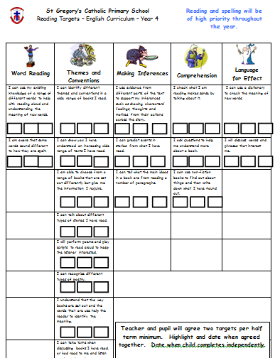
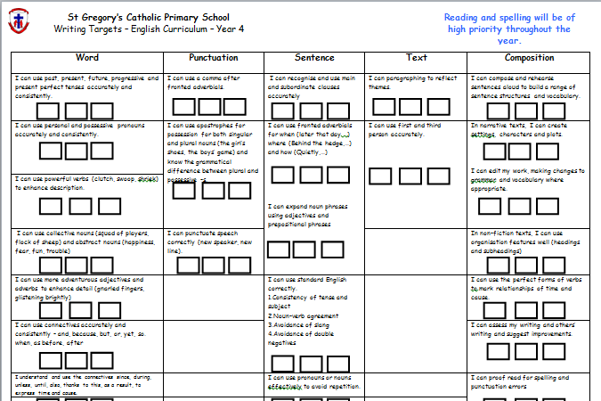
Year Group Targets
Each year group has their own set of targets for Reading, Writing and Maths. These can be found on the website on each class page. Each half term, children will highlight at least two targets in each area and class teachers will date the target once they have seen evidence of the child achieving it.

Slide 15
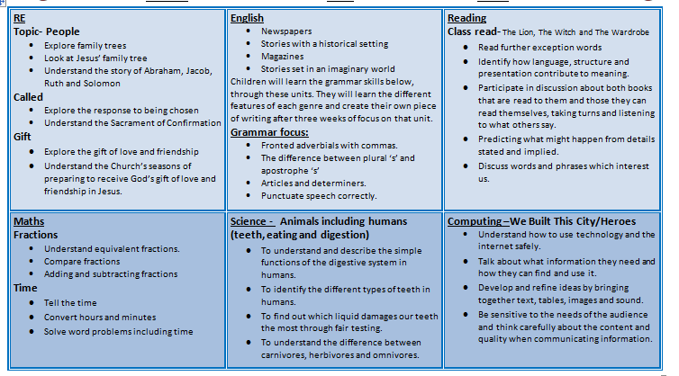
Overview of Subjects
Each of the following slides show our long term plans of what each year group are learning about throughout the year. You can also find out what your child is learning about in more depth by viewing the curriculum map on each class page on the website.

Slide 16

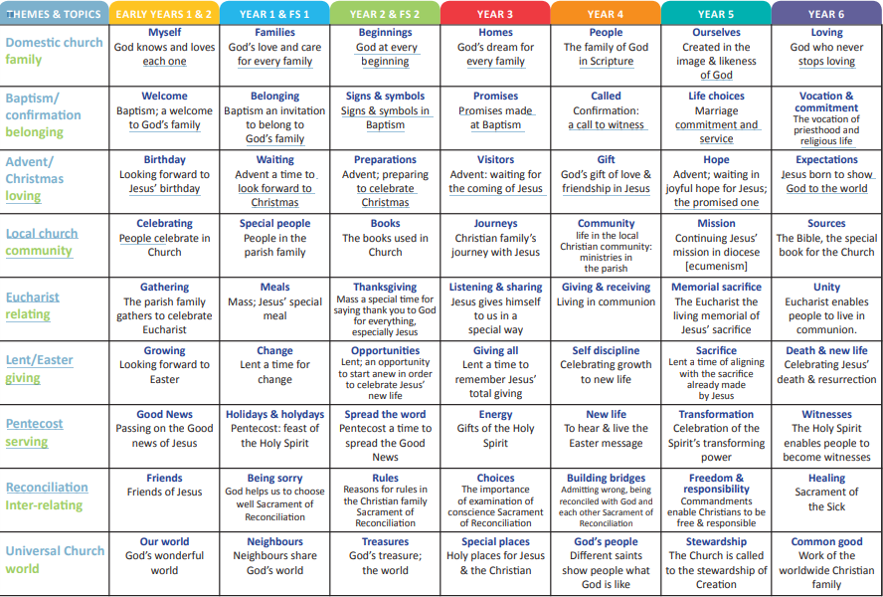
Religious Education

Slide 17
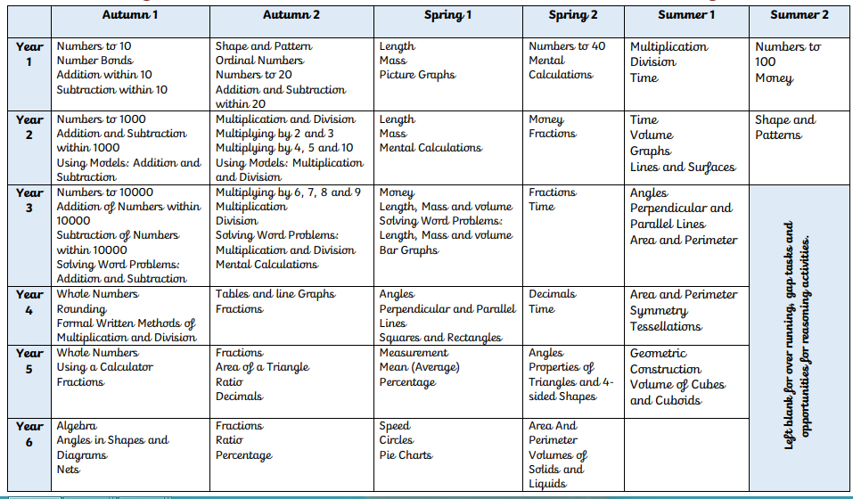
Maths

Slide 18
English
Year Group | Genre | Year Group | Genre
Nursery/Reception | Read, Write, Inc Structure of Stories Communication and language
Y1 | Labels & Captions Stories with familiar settings Recounts- Fact and fiction Dictionary skills Poetry- Using senses Traditional and Fairytales Instructions Stories from other cultures Poetry- Pattern and Rhyme Fantasy settings Information texts Poetry-poems on a theme | Y3 | Familiar settings Explanation texts Myths Adventure stories Shape poems Poems to perform Instructions Stories by the same authors
Y2 | Explanation Texts Stories with familiar settings Information texts Traditional stories Patterns on a pge poetry Different stories by the same author Instructions Poetry- really looking Significant authors Non-Chronological reports Poetry- Silly Stuff | Y4 | Stories with historical settings Stories from other cultures Explanation texts Advertisements Poetry- Creating images Play scripts Persuasive writing Stories with imaginary settings Newspapers Magazines Stories with issues and dilemmas Poetry- exploring form

Slide 19
English
Year Group | Genre | Year Group | Genre
Y5 | Novels and stories by significant Children’s authors Instructions Traditional Stories and Legends Poetic Style Stories from Other Cultures Recounts Older Literature Classic Poetry/ Narrative Poems Persuasive Writing Film Narrative Dramatic Conventions Choral and Performance | Y6 | Poetry- Imagery Biography Auto-biography Balanced/unbalanced arguments Flashbacks Time slips Journalistic writing Letter writing Formal/Impersonal writing Play scripts Action stories Revise-Myths, Legends, Diaries
Each class is taught one GPS focus lesson a week. This is then followed up in the writing of each genre. The GPS focus along with specific year group objectives can be found on the curriculum map and target sheets on each class page on the website.

Slide 20
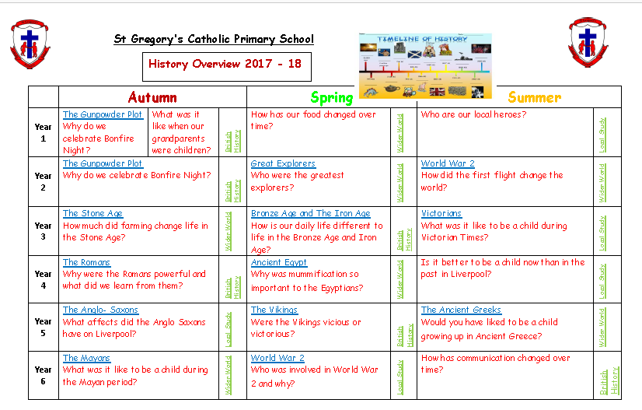

Slide 21
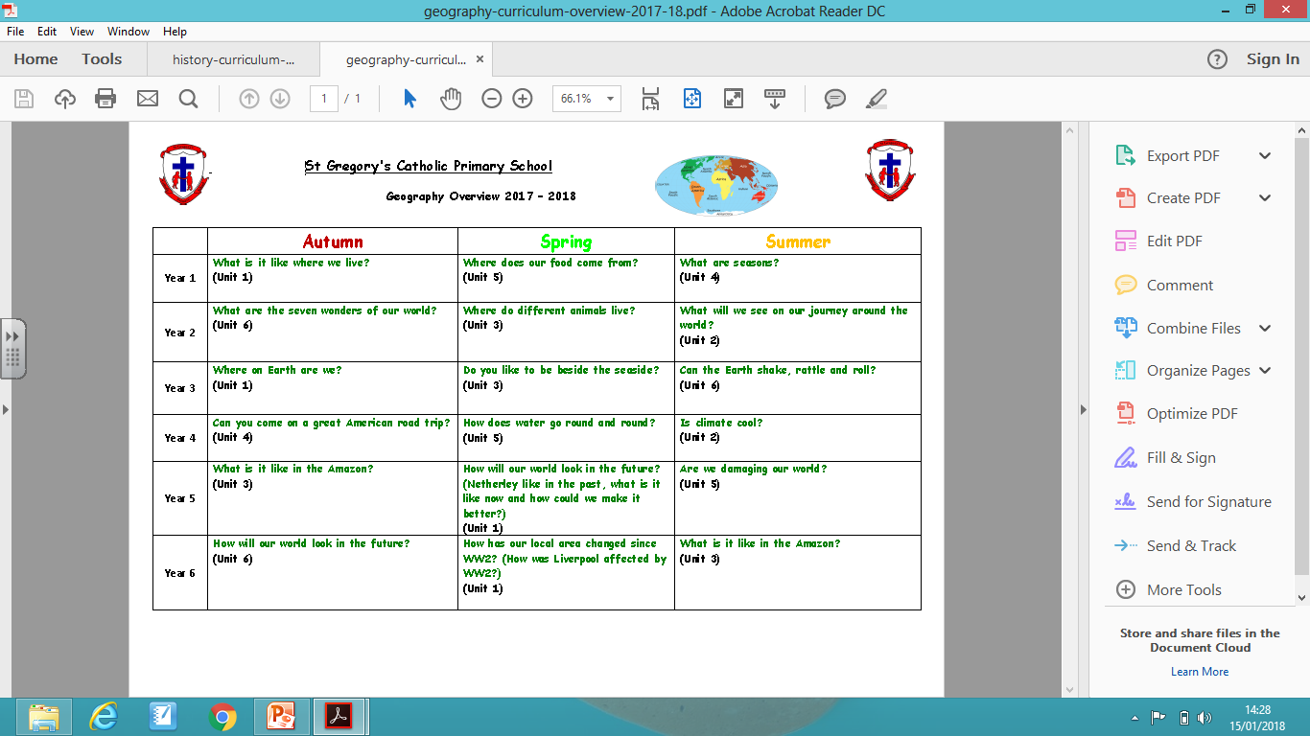

Slide 22


PE
 | Autumn 1 | Autumn 2 | Spring 1 | Spring 2 | Summer 1 | Summer 2
R | Fundamental Movement Skills | Fundamental Movement Skills | Fundamental Movement Skills | Fundamental Movement Skills | Athletics | Fundamental Movement Skills
Y1 | Gymnastics | Dance | Team Games (Invasion) | Team Games (Net/Wall) | Athletics | Team Games (Striking & Fielding)
Y2 | Gymnastics | Dance | Team Games (Invasion) | Team Games (Net/Wall) | Athletics | Team Games (Striking & Fielding)
Y3 | Gymnastics | Dance | Team Games (Invasion) | Team Games (Net/Wall) | Athletics | Team Games (Striking & Fielding)
Y4 | Gymnastics | Dance | Team Games (Invasion) | Team Games (Net/Wall) | Athletics | Team Games (Striking & Fielding)
Y5 | Gymnastics | Dance | Team Games (Invasion) | Team Games (Net/Wall) | Athletics | Team Games (Striking & Fielding)
Y6 | Gymnastics | Dance | Team Games (Invasion) | Team Games (Net/Wall) | Athletics | Team Games (Striking & Fielding)

Slide 23
Computing
Year Group | Online Safety | Autumn | Spring | Summer
Reception | Digital Citizenship & Technology (DL) Lv1 | Little Computers (CS) Let’s Celebrate (DL) | A is for Algorithm (CS) Art Attack (DL) | Junior Explorers (CS) Fantastic Tales (DL)
Year 1 | Digital Citizenship & Technology (DL) Lv1 | We are all Connected (CS) Pictures Tell a Thousand Words | Walking with Dinosaurs (CS) Our Local Area (IT, DL) | App Attack - Games Design (CS) Pictures Tell a Thousand Words
Year 2 | Digital Citizenship & Technology (DL) Lv1 | You’ve got mail (CS, IT, DL) Whatever the Weather (IT) | Code-tastic (CS) Super Sci-Fi (IT, DL) | Let's Fix IT (CS) Vehicles (IT, DL)
Year 3 | Digital Citizenship & Technology (DL) Lv2 | Big Robots (CS) Get Blogging (CS, IT, DL) | We love Games (CS) Class Democracy (IT, DL) | Young Coders (CS, IT) We are Publishers (DL)
Year 4 | Digital Citizenship & Technology (DL) Lv2 | Back to the Future (CS) Heroes (CS, IT) | Cars (CS) Hurray for Hollywood (DL) | Interface Designer (CS) Final score (DL)
Year 5 | Digital Citizenship & Technology (DL) Lv3 | Making Games (CS) Grand Designs (DL, IT) | Maths & Cryptography (CS) Interactive Art Exhibition (DL) | Web Site Designers (CS) Let's change the world: Inventors (CS, DL)
Year 6 | Digital Citizenship & Technology (DL) Lv3 | Let's learn a language (CS) Heroes & Villains -Graphics (DL) | Appy Times Pt 1 (CS) Around the World (CS, IT, DL) | Appy Times Pt 2 (CS) Young Authors - interactive (IT, DL)

Slide 24
Online Safety
Date | Nursery | Reception | Y1 | Y2 | Y3 | Y4 | Y5 | Y6
WKB 04.09.17 | Smartie the penguin | What information must we keep safe? | Why must we keep information safe? | Why must we keep personal information safe? | The risks of using the internet | What are the risks of the online world? | How to reduce the risks of your online behaviour. | What are the risks of using the internet?
06.10.17 |  |  |  |  | Online Safety Drama. Outside agency | Online Safety Drama and workshops | Online Safety Drama and workshops | Online Safety Drama and workshops
08.10.17 | Digital Parenting Magazines to be distributed to all parents.
WKB 30.10.17 | Digiducks big decision | Smartie the penguin | Who do you trust? | Introducing online life and what it is. | Communicating online, images and social networking. | Communicating online, images and social networking. | Communicating online, images and social networking. | Communicating online, social networking, sexting, images and grooming.
WKB 9.01.17 | Penguinpig | Digiducks big decision | Sending e-mails and messages. | What is Cyber-bullying? | Cyber bullying and report abuse | Cyber bullying and report abuse. | Cyber bullying and report abuse. | Cyber bullying and report abuse
06.02.17 | Online Safety Day | Online Safety Day | Online Safety Day | Online Safety Day | Online Safety Day | Online Safety Day | Friend or foe? | Copy right, what is it?
WKB 19.02.18 | Chicken clicking | Penguinpig | Smartie the penguin | Chicken clicking | Gaming and collaboration | Copy right, what is it? | Online Safety Day | Online Safety Day
WKB 09.04.18 | Webster’s bedtime | Chicken clicking | Digiducks big decision | Webster’s friend | Friend or Foe? | Passwords and security. | Copy right, what is it? | Gaming and collaboration.
WKB 11.06.17 | Webster’s friend | Webster’s bedtime | Penguinpig | Webster’s e-mail | Penguinpig | Digiducks big decision | Gaming and collaboration. | Webster’s e-mail.

Slide 25

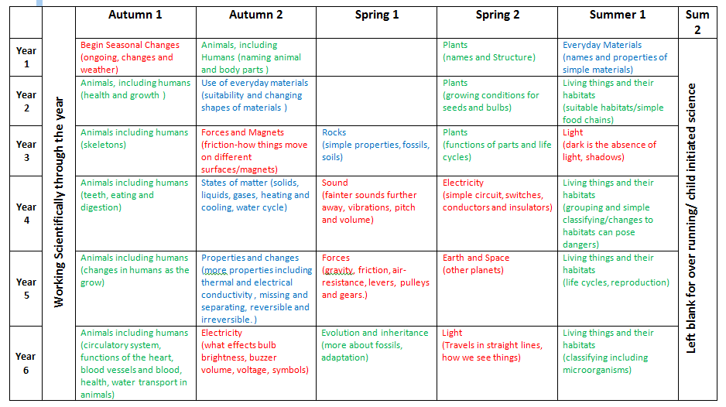
Science

Slide 26
PSHE
Year Group | Areas of PSHE covered
EYFS | Self-confidence and self-awareness Managing feelings and behaviour Making relationships
Years 1-6 | Health & Wellbeing Relationships Living in the wider world
The whole school also participate in PSHE days, each with a different focus. Such as; E-safety, Anti-bullying week, Alcohol awareness day, Road safety week, Fire Safety, Stranger Danger, Remembrance Day, National Careers week, Mental health awareness and NSPCC.

Slide 27
Spanish
Year Group | Topic Covered
Reception | Personal questions/Greetings/Class instructions/ Colours/Animals/Numbers up to 15/parts of the face/Fruit.
Year 1 | Personal questions/Greetings/Class instructions/ Colours/Animals/Numbers up to 20/parts of the face/Shapes
Year 2 | Personal questions/Greetings/Class instructions and objects/ Colours/Animals/Numbers up to 30/Parts of the body/Transport/Sea creatures/Feelings/Weather/Transports/Habitats/ Adjectives/Colours
Year 3 | Personal questions/Classroom instructions/Greetings/Days /Months/Numbers to 40/Parts of the body/Animals/Nationalities and countries/Colours/Pet animals/Adjectives/Kitchen utensils/Likes and dislikes/Fruit

Slide 28
Spanish
Year Group | Topic Covered
Year 4 | Personal questions/Classroom instructions/Greetings/3rd person/Negative form/Days/Months/Numbers to 50/Body parts/Dates/School subjects/Weather/Family members
Year 5 | Personal questions/Classroom instructions/Alphabet and vowels/Parts of the body/Illnesses/Daily routine/School uniform/Telling the time/Holiday clothes/Actions/Likes and dislikes
Year 6 | Personal questions/Classroom instructions/Parts of the body/Numbers to 500/Actions/Adjectives/Likes and dislikes/Colours/Rooms of a house/Places in town/How to get to …/Professions/Articles/Drinks/Food (How to order in a restaurant)

Slide 29
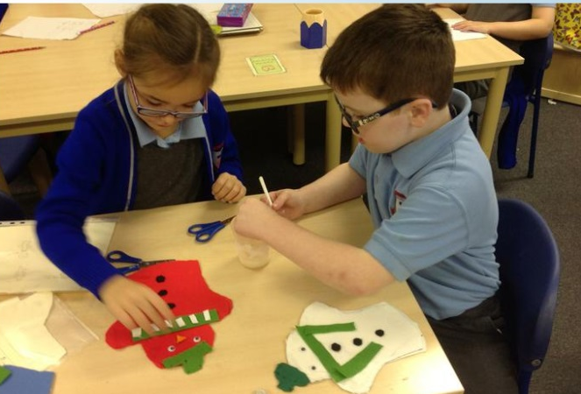
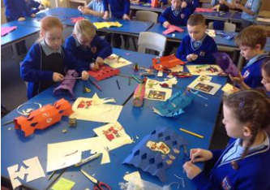
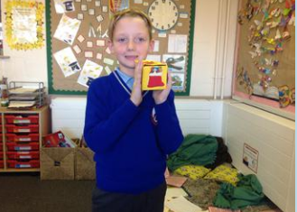
Design Technology
DT in St Gregory’s is delivered during DT themed weeks with a specific outcome such as Christmas Markets and Summer Fayre.
It is also delivered, where possible and relatable, through the different topics in each year.
Year groups 1-6 also receive cookery lessons for at least one half term during the academic year.

Slide 30

Art
We follow the scholastic scheme of work for year 1-6. Each year group covers four aims;
Exploring and creating
Skills and techniques
Evaluate and analyse
Art and artists
Each year group will cover these four aims through different themes, topics and artists.

Slide 31
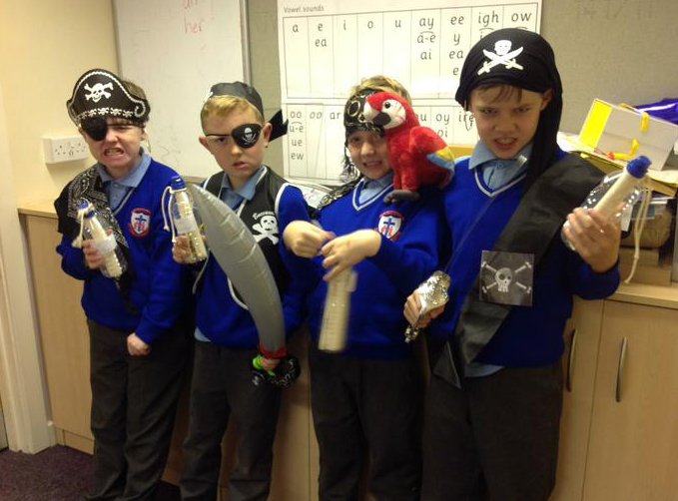
Interventions
Interventions are set up between the class teacher and teaching assistant. Most interventions take place during the afternoon. Children who are not achieving the expected standard for their year group are targeted in Reading, Writing or Maths interventions. We follow First Class at Writing and First Class at Number intervention programmes.
Look at the different class pages on the website to find out about the writing interventions and also see pictures of the children enjoying them.
“I like working on my handwriting and talking about pirates in the writing group.”- Year 4 Pupil.

Slide 32

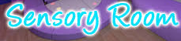
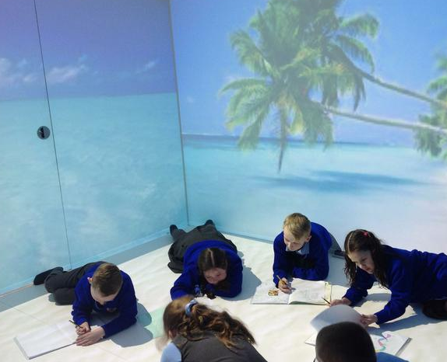

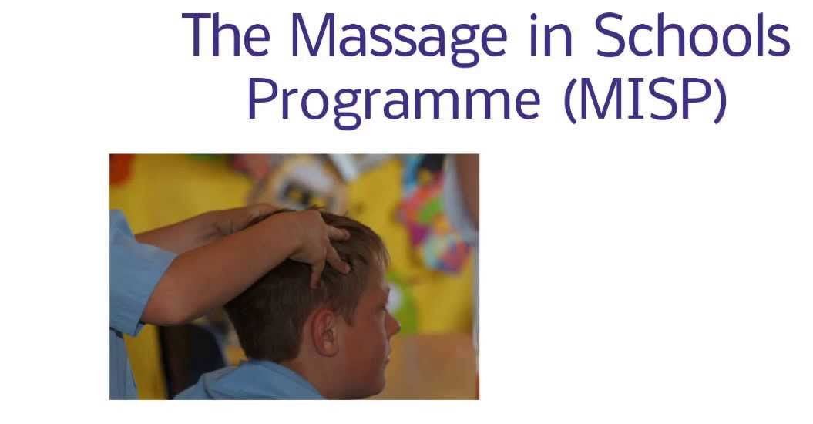



Additional Support Programmes
Therapy
Immersive
Space
School Family Support Service

Slide 33

Global Learning
“A GLOBAL CITIZEN IS SOMEBODY WHO CONTRIBUTES TO THE WIDER WORLD COMMUNITY. THEY DON’T JUST FOLLOW THE CROWD, THEY ARE THEIR OWN PERSON AND
THEY WANT TO MAKE A DIFFERENCE BUT THEY KNOW THEY CAN’T DO IT ON THEIR OWN.”
What is a Global Citizen?
Oxfam sees the Global Citizen as someone who:
• is aware of the wider world and has a sense of their own role as a
world citizen
• respects and values diversity
• has an understanding of how the world works
• is passionately committed to social justice
• participates in the community at a range of levels, from the local
to the global
• works with others to make the world a more equitable and
sustainable place
• takes responsibility for their actions
Children learn about sustainability in a variety of ways , e.g. learning about how to protect the rainforest and the impact that it has on the wider world. Staff are creative with ways to link the GLP themes .
In history children learn about the lives of significant people: the children learn about different people who have stood up for human rights and they learn to write a recount in literacy, and develop their ICT skills by researching these people.
In geography we look at forests in the UK and Brazil: the children learn about deforestation and consider how they can make a difference. We study earthquakes and volcanoes: the children consider the impact of earthquakes, e.g. in Haiti. They consider whether charities are the right solution to solve some of the issues created by natural disasters.

Slide 34


Citizens of the world
Through the teaching of different subjects and topics, we teach our pupils to be:
Understanding Compassionate Honest Responsible Respectful Resilient
Through these values, our pupils can become:
Scientists Teachers Doctors Architects Engineers or any other profession they choose.

